Slide 1
Lecture 16-Skewness
28-08-2023

Slide 2
What is Skewness?
Skewness refers to a distortion or asymmetry that deviates from the symmetrical bell curve, or normal distribution, in a set of data.
If the curve is shifted to the left or to the right, it is said to be skewed. Skewness can be quantified as a representation of the extent to which a given distribution varies from a normal distribution.
A normal distribution has a skew of zero, while a lognormal distribution, for example, would exhibit some degree of right-skew.

Slide 3
Features of Skewness
Skewness, in statistics, is the degree of asymmetry observed in a probability distribution.
Distributions can exhibit right (positive) skewness or left (negative) skewness to varying degrees. A normal distribution (bell curve) exhibits zero skewness.
Investors note right-skewness when judging a return distribution because it, like excess kurtosis, better represents the extremes of the data set rather than focusing solely on the average.

Slide 4
Details on Skewness
Besides positive and negative skew, distributions can also be said to have zero or undefined skew.
In the curve of a distribution, the data on the right side of the curve may taper differently from the data on the left side.
These tapering's are known as "tails.“
Negative skew refers to a longer or fatter tail on the left side of the distribution, while positive skew refers to a longer or fatter tail on the right.

Slide 5
Details on Skewness
The mean of positively skewed data will be greater than the median.
In a distribution that is negatively skewed, the exact opposite is the case: the mean of negatively skewed data will be less than the median.
If the data graphs symmetrically, the distribution has zero skewness, regardless of how long or fat the tails are.

Slide 6
Details on Skewness
The three probability distributions depicted below are positively-skewed (or right-skewed) to an increasing degree.
Negatively-skewed distributions are also known as left-skewed distributions.

Slide 7
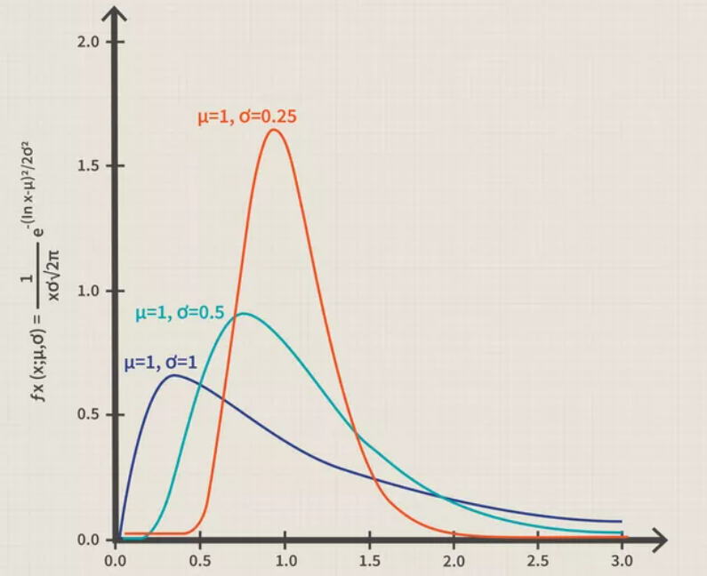
Skewness

Slide 8
Measures of Skewness:
Skewness formula is called so because the graph plotted is displayed in skewed manner.
Skewness is a measure used in statistics that helps reveal the asymmetry of a probability distribution.
It can either be positive or negative, irrespective of signs.
To calculate the skewness, we have to first find the mean and variance of the given data.

Slide 9

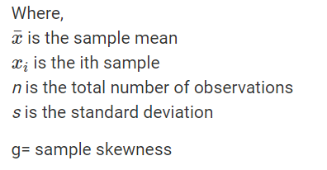
Calculate Skewness
Step 1: Find the mean and variance of the given data
Step 2: The formula for Sample Skewness is :

Slide 10
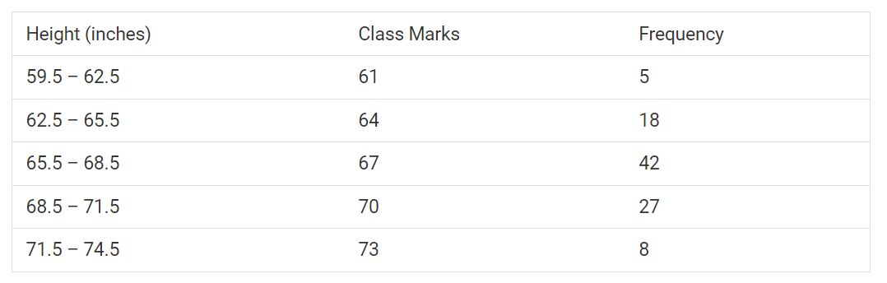
Find the skewness in the following data

Slide 11
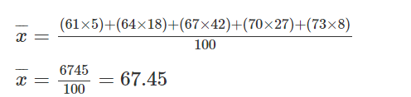
Step 1:
To know how skewed these data are as compared to other data sets, we have to compute the skewness.
Sample size and sample mean should be found out.
N = 5 + 18 + 42 + 27 + 8 = 100

Slide 12
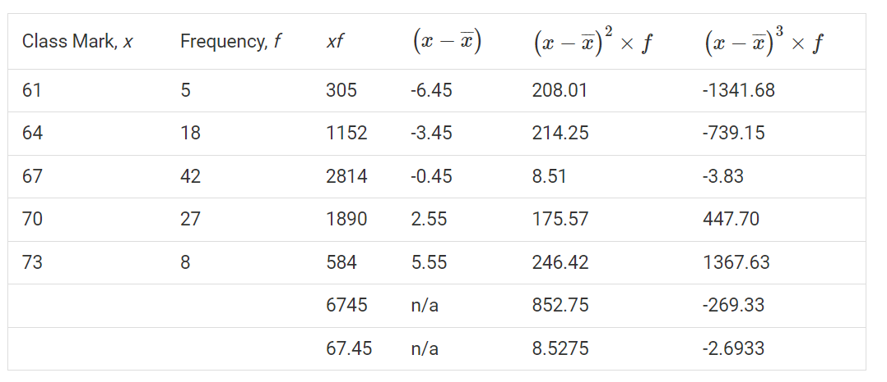
Step 2: Compute the skewness

Slide 13
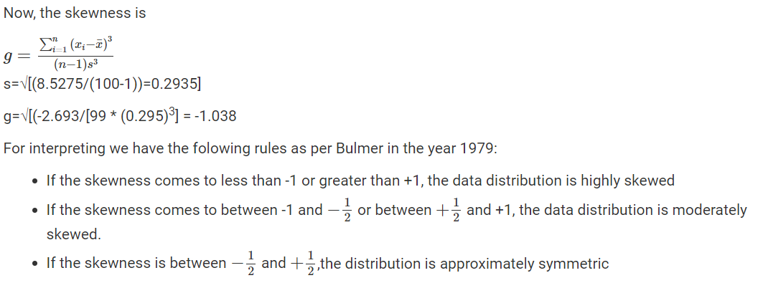

Slide 14
Another Method to measure Skewness
Pearson’s first and second coefficients of skewness are two common ones.
Pearson’s first coefficient of skewness, or Pearson mode skewness, subtracts the mode from the mean and divides the difference by the standard deviation.
Pearson’s second coefficient of skewness, or Pearson median skewness, subtracts the median from the mean, multiplies the difference by three, and divides the product by the standard deviation.

Slide 15
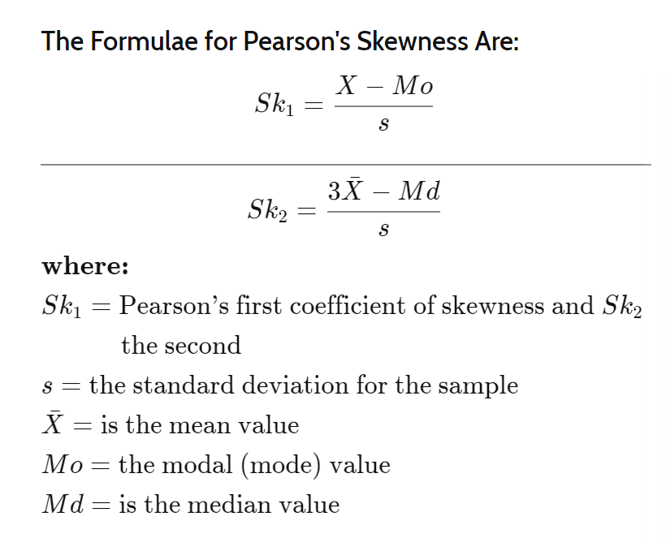

Slide 16
Importance of Pearson's Coefficient
Pearson’s first coefficient of skewness is useful if the data exhibit a strong mode.
If the data have a weak mode or multiple modes, Pearson’s second coefficient may be preferable, as it does not rely on mode as a measure of central tendency.

Slide 17
Practical Importance of Skewness
Let it be the example of Investors .
Investor note skewness when judging a return distribution because it, like kurtosis, considers the extremes of the data set rather than focusing solely on the average.
Short- and medium-term investors in particular need to look at extremes because they are less likely to hold a position long enough to be confident that the average will work itself out.
Investors commonly use standard deviation to predict future returns, but the standard deviation assumes a normal distribution.

Slide 18
Risk with Skewness
As few return distributions come close to normal, skewness is a better measure on which to base performance predictions. This is due to skewness risk.
Skewness risk is the increased risk of turning up a data point of high skewness in a skewed distribution.
Many financial models that attempt to predict the future performance of an asset assume a normal distribution, in which measures of central tendency are equal.
If the data are skewed, this kind of model will always underestimate skewness risk in its predictions.
The more skewed the data, the less accurate this financial model will be.

Slide 19
Bowley's Coefficient of Ske wness for Ungrouped data
Skewness is a measure of symmetry. The meaning of skewness is “lack of symmetry”.
Skewness gives us an idea about the concentration of higher or lower data values around the central value of the data.

Slide 20
Bowley's Coefficient
Bowley's Coefficient of Skewness is also known as Quartile Coefficient of skewness.
Specially used where quartile and medians are used
When the mode is ill –defined and extreme observations are present in the data
When distributions has open end classes and unequal class intervals
In these situations Pearson coefficient of skewness cannot be used.

Slide 21
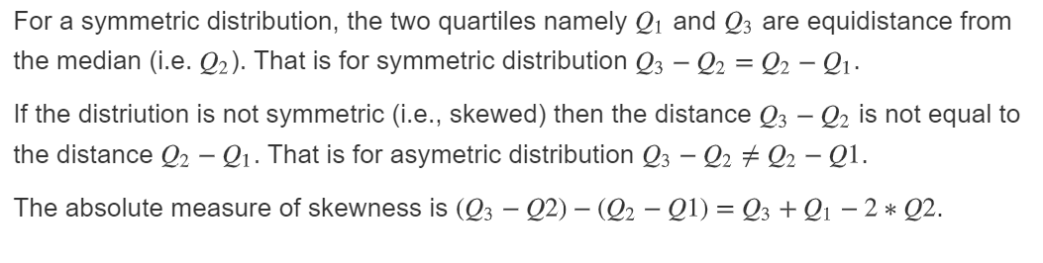
Bowley's Coefficient

Slide 22
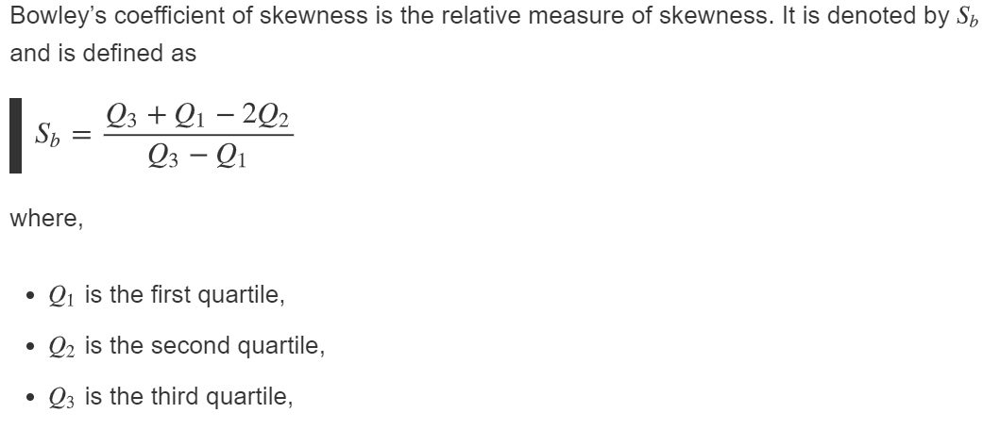
Formula for Bowley's Coefficient

Slide 23
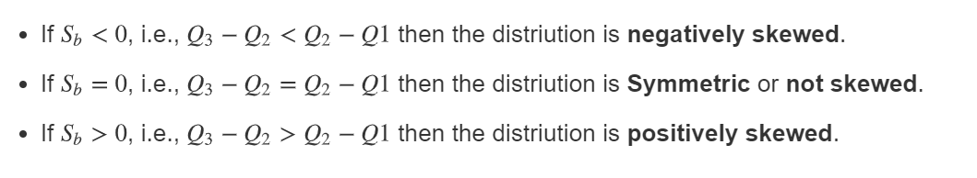
Types of Skewness
Bowley’s coefficient of skewness ranges from -1 to +1

Slide 24
Example
A random sample of 15 patients yielded the following data
on the length of stay (in days) in the hospital.
5, 6, 9, 10, 15, 10, 14, 12, 10, 13, 13, 9, 8, 10, 12.
Find Bowley’s coefficient of skewness.

Slide 25

Step 1:
The formula for i^{th} quartile is
observation, i=1,2,3
where n is the total number of observations.
Arrange the data in ascending order
5, 6, 8, 9, 9, 10, 10, 10, 10, 12, 12, 13, 13, 14, 15

Slide 26
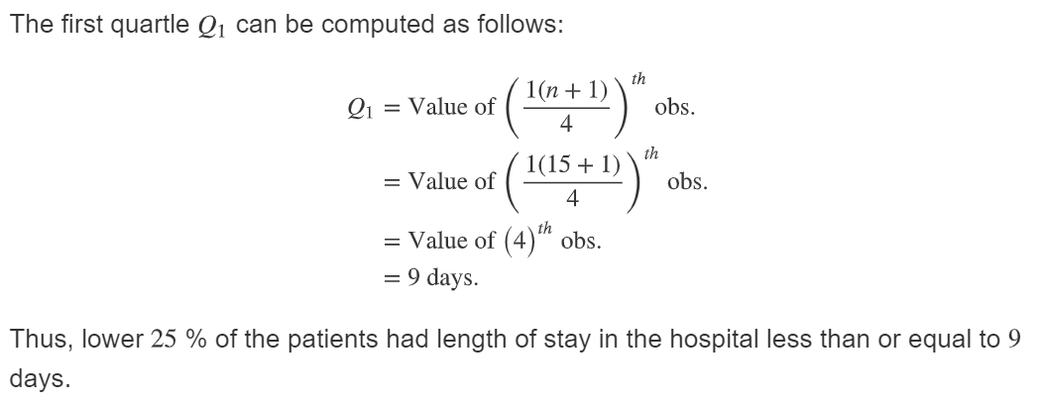
Step 2: First Quartile Q1

Slide 27
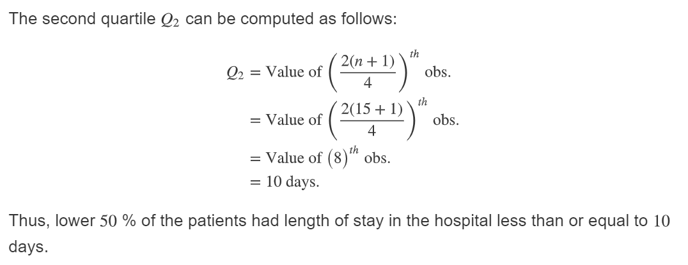
Second Quartile

Slide 28
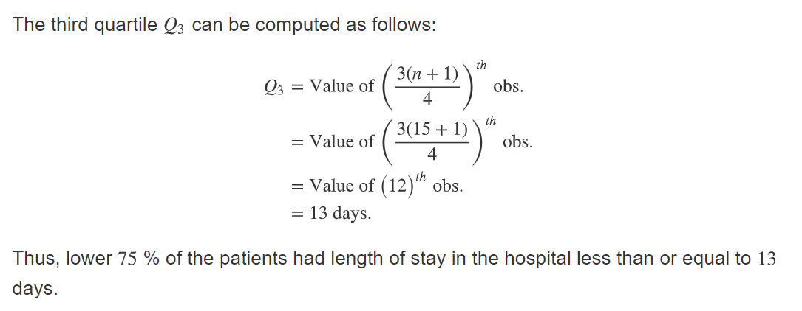
Third Quartile

Slide 29
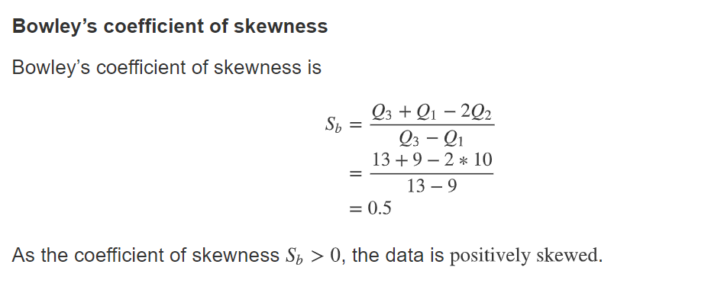
Step 4: Computation of Bowley s coefficient

Slide 30
Coefficient Based Upon Moments
The coefficient of skewness measures the skewness of a distribution.
It is based on the notion of the moment of the distribution. This coefficient is one of the measures of skewness.
Central Moments- The average of all the deviations of all observations in a dataset from the mean of the observations raised to the power r

Slide 31
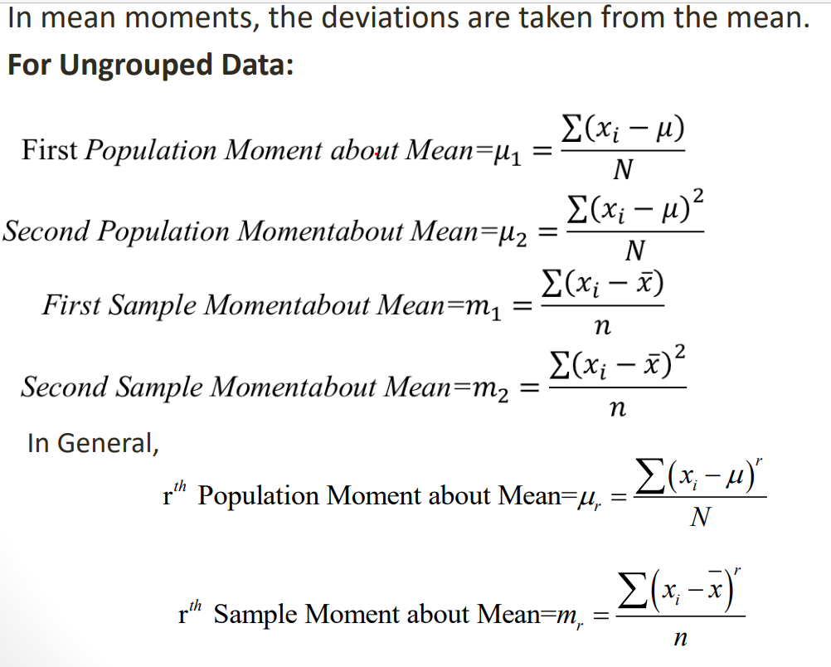
Mean Moments

Slide 32
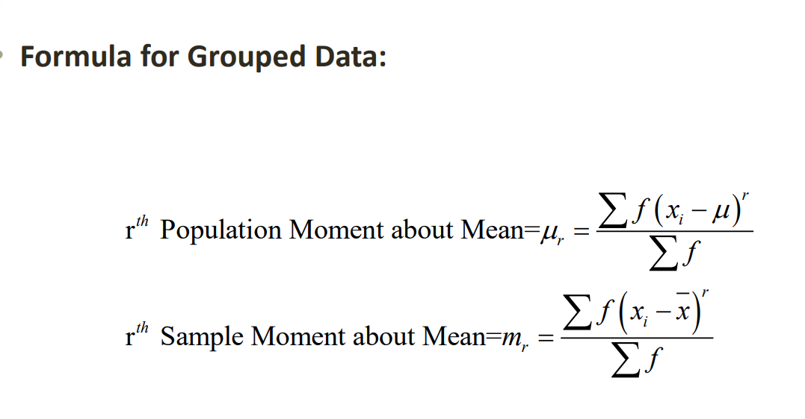
Central(Mean)Moments

Slide 33
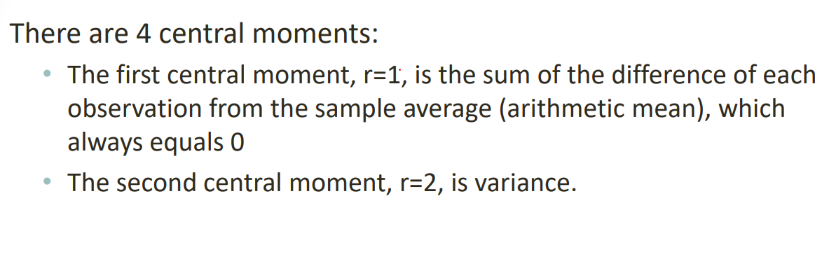
Types of Central Moments

Slide 34
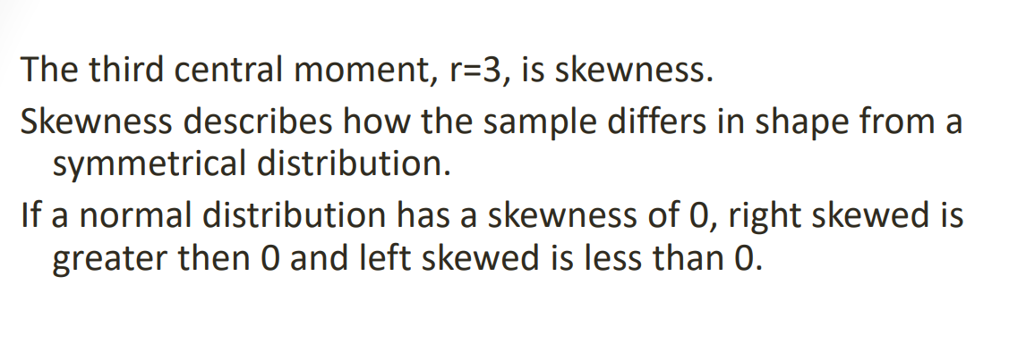
Types of Central Moments

Slide 35
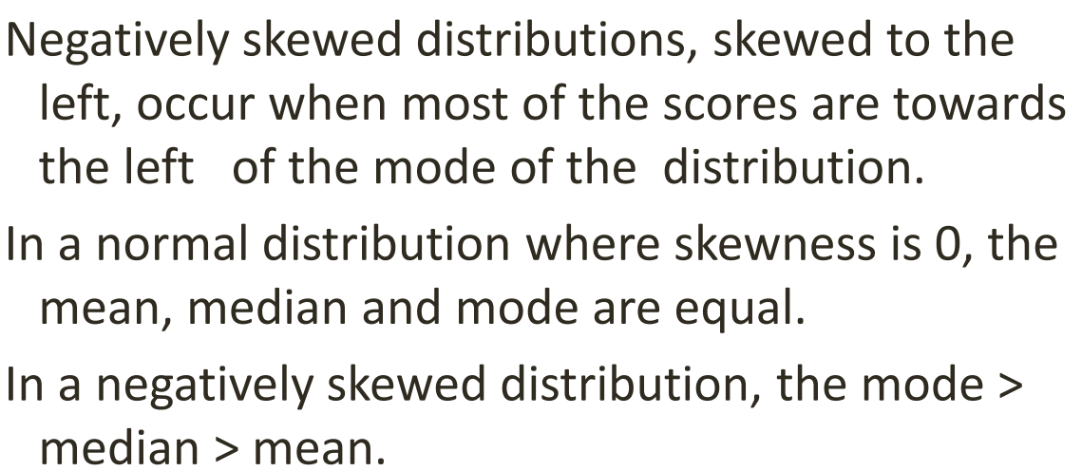
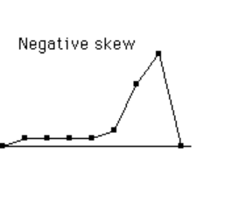
Negative Skewed Distribution -Revision

Slide 36
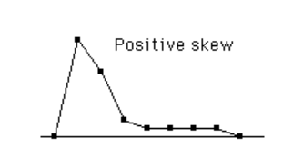
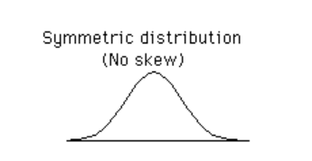
Positively skewed distributions
Positively skewed distributions occur when most of the scores are towards the right of the mode of the distribution. In a positively skewed distribution, mode< median< mean

Slide 37
Kurtosis
Karl Pearson introduced the term Kurtosis (literally the amount of hump) for the degree of peakedness or flatness of a unimodal frequency curve. When the peak of a curve becomes relatively high then that curve is called Leptokurtic. When the curve is flat-topped, then it is called Platykurtic. Since normal curve is neither very peaked nor very flat topped, so it is taken as a basis for comparison. The normal curve is called Mesokurtic

Slide 38
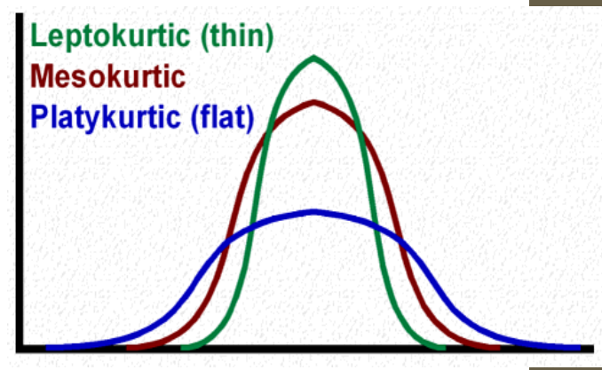
Kurtosis-Diagram

Slide 39
Kurtosis central moment
Kurtosis is the 4th central moment.
This is the “peakedness” of a distribution. It measures the extent to which the data are distributed in the tails versus the center of the distribution
There are three types of peakedness. Leptokurtic- very peaked Platykurtic – relatively flat Mesokurtic – in between

Slide 40
Example:
The Frequency distributions of scores in Exlporatory Data Anaslysis subject for 50 students are as follows:
Score | 50-60 | 60-70 | 70-80 | 80-90 | 90-100 | 100-110 | 110-120 | 120-130 | 130-140
Frequency | 1 | 0 | 0 | 1 | 1 | 2 | 1 | 0 | 4
Score | 140-150 | 150-160 | 160-170 | 170-180 | 180-190 | 190-200 | 200-210 | 210-220 | 220-230
Frequency | 4 | 2 | 5 | 10 | 11 | 4 | 1 | 1 | 2
Use Above data and compute the First Four Moment about Mean and then find moment of coefficient of skewness and Kurtosis and Comments on nature of distributions?

Slide 41
Step 1
Mid Value (x) | f | d= (x-135)/10 | f*d | f*d*d | f*d*d*d | f*d*d*d*d
55 | 1 | -8 | -8 | 64 | -512 | 4096
65 | 0 | -7 | 0 | 0 | 0 | 0
75 | 0 | -6 | 0 | 0 | 0 | 0
85 | 1 | -5 | -5 | 25 | -125 | 625
95 | 1 | -4 | -4 | 16 | -64 | 256
105 | 2 | -3 | -6 | 18 | -54 | 162
115 | 1 | -2 | -2 | 4 | -8 | 16
125 | 0 | -1 | 0 | 0 | 0 | 0
135 | 4 | 0 | 0 | 0 | 0 | 0
145 | 4 | 1 | 4 | 4 | 4 | 4
155 | 2 | 2 | 4 | 8 | 16 | 32
165 | 5 | 3 | 15 | 45 | 135 | 405
175 | 10 | 4 | 40 | 160 | 640 | 2560
185 | 11 | 5 | 55 | 275 | 1375 | 6875
195 | 4 | 6 | 24 | 144 | 864 | 5184
205 | 1 | 7 | 7 | 49 | 343 | 2401
215 | 1 | 8 | 8 | 64 | 512 | 4096
225 | 2 | 9 | 18 | 162 | 1458 | 13122
Total | 50 |  | 150 | 1038 | 4584 | 39834

Slide 42
Step 2:Computation of the raw moment
The raw moment | M1= | 150/50
M1= ∑fd/∑f |  | 3
M2= ∑fd*d/∑f | M2= | 1038/50
 |  | 20.76
M3= ∑fd*d*d/∑f | M3= | 4584/50
 |  | 91.68
M4= ∑fd*d*d*d/∑f | M4= | 39834/50
 |  | 796.68

Slide 43
Step 3: Computation of Central Moment
height=h=10
Central Moments of variable x |  | m2=
(M2-M1*M1)*h*h |  | 1176
Central Moments of variable x |  | m3=
(M3-3M2*M1)+ 2M1*M1*M1* h*h*h |  | -41160
Central Moments of variable x |  | m4=
(M4-4M3*M1+6 M2*M1*M1-3 M1*M1*M1*M1)* h*h*h*h |  | 5745600

Slide 44
Step 4:Compute Moment Coefficient of Skewness= Y1 and comment
Y1=M3/(M2+ sqare root M2) | (minus)41160/1176* sqare root of (1176) | (minus)41160/1176* sqare root of (1176)
 | -1.02 | =-1.02
It means that Negative skewed
The frequency curve of the given distribution
has longer tail
toward the left

Slide 45
Moment of Coefficient of Kurtosis (Beta2)
Beta 2=M4/M2*M2=5745600/(1176)*1176=4.15
Interpretation:
Beta 2 is greater than 3 (More than M1) . Hence the distribution is leptokurtic .
That means Frequency Curve is more peaked (thin) than the normal curve.

Slide 46
Thanks !!!

